Slide 1


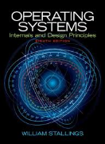
Welcome to
CS 345 Operating Systems
Computer Systems, Part 2 (04)

Slide 2
Event-driven programming
Event-driven programming is a programming paradigm in which the flow of the program is determined by
sensor outputs,
user actions (mouse clicks, key presses), or
messages from other programs or threads.
interrupts
Application has a main loop
Event selection (scheduler).
Event handling (dispatcher).
Events are external to a task
Signals are asynchronous events
Occur anytime, handled by call-back functions
Semaphores are synchronous events.
Occur anytime, handled by semaphores

Slide 3
Project 1.4 Signals
A signal is an asynchronous notification of an event that is sent to a process before it is rescheduled for execution.
Blocked processes are not un-blocked by a signal, but rather the signal remains pending until such time as the process is un-blocked and scheduled for execution.
Before a task is scheduled by the function dispatcher (os345.c), the function signals (os345signals.c) is called:
Modify the function signals (os345signals.c) to call all pending task signal handlers.
Modify the function createTaskSigHandlers (os345signals.c) such that a child task inherits all its parent signal handlers.
Modify the function sigAction (os345signals.c) to register new task signal handlers.
Add default signal handlers as needed.
Implement all signals and signal handlers such that:
Cntrl-X terminates (kills) all tasks except task 0 (shell).
Cntrl-W pauses the execution of all tasks.
Cntrl-R continues the execution of all tasks after a pause.

Slide 4
Project 1.4 Signals Example
Dispatcher calls signal handlers before rescheduling task:
void mySIGINTHandler(void) void mySIGTERMHandler(void)
{ sigSignal(-1, SIGTERM); { killTask(curTask);
return; return;
} }
keyboard_isr() detects a cntrl-X and sends a SIGINT signal to the shell:
sigSignal(0, SIGINT);
Task registers call-back signal handler functions with the OS:
sigAction(mySIGINTHandler, SIGINT);
sigAction(mySIGTERMHandler, SIGTERM);
createTask()
dispatch()
sysKillTask()
New
Ready
Running
Exit
SWAP
createTask calls createTaskSigHandlers() to setup
default / parent signal handlers:
void createTaskSigHandlers(int tid)
{ tcb[tid].sigIntHandler = defaultSigIntHandler;
tcb[tid].sigTermHandler = defaultSigTermHandler;
return;
}

Slide 5
Keyboard Interrupts
Keyboard Input | Action
Cntrl-X | sigSignal SIGINT to shell Clear input buffer semSignal inBufferReady
Cntrl-R | sigSignal SIGCONT to all tasks Clear SIGSTOP from all tasks Clear SIGTSTP from all tasks
Cntrl-W | sigSignal SIGTSTP to all tasks

Slide 6
Signal Handling
Signal | PollInterrupts | Scheduler | Dispatcher | Signal Handler
SIGCONT | Cntrl-R sigSignal(-1,SIGCONT); **Clear SIGSTOP and SIGTSTP in all tasks | - | Clear SIGCONT Call sigContHandler() Schedule task | return;
SIGINT | Cntrl-X sigSignal(-1,SIGINT); | - | Clear SIGINT Call sigIntHandler() Schedule task | sigSignal(-1,SIGTERM);
SIGTERM | - | - | Clear SIGTERM Call sigTermHandler() **DO NOT schedule task | killTask(curTask); NOTE: killTask does not terminate shell.
SIGTSTP | Cntrl-W sigSignal(-1,SIGTSTP); | - | Clear SIGTSTP Call sigTstpHandler() **DO NOT schedule task | sigSignal(-1,SIGSTOP);
SIGSTOP | - | TASK NOT SCHEDULED | - | -

Slide 7
Project 1 File Summary…
Files needing attention:
os345tasks.c – createTask, sysKillTask
os345interrupts.c – keyboard_isr
os345signals.c – signals, sigAction, sigSignal, defaultSigxxHandler, createTaskSigHandlers
os345p1.c – P1_shellTask, P1_help …
os345.h – your equates
Signal Event Handlers
int signals(void);
int sigAction(void (*sigHandler)(void), int sig);
int sigSignal(int taskId, int sig);
void defaultSigxxxHandler(void);
void createTaskSigHandlers(int tid)

Slide 8
Project 1 Pass-off
Use P1& to test background tasks:
int P1_project1(int argc, char* argv[])
{
int p1_mode = 0;
if (argc > 1) p1_mode = atoi(argv[1]);
switch(p1_mode)
{
default:
case 0:
int j;
for (j = 0; j < 4; j++)
{
int i;
printf("\nI'm Alive %d,%d", curTask, j);
for (i = 0; i < 100000; i++) swapTask();
}
break;
case 1:
// create 3 tasks
break;
}
return 0;
} // end P1_project1
myOS345
c:\lcc\projects\pros345.exe
New Task[0] myShell
0>>lt
0/0 myShell 5 Running
3>>p1
I'm Alive 0,0lt
I'm Alive 0,1
I'm Alive 0,2
I'm Alive 0,3
400005>>
0/0 myShell 5 Running
400008>>p1&
400011>>
New Task[1] p1
I'm Alive 1,0lt
0/0 myShell 5 Running
1/0 p1 5 Ready
486881>>
I'm Alive 1,1
I'm Alive 1,2
I'm Alive 1,3
Task[1] returned 0
Use P3 to test ^x, ^w, and ^r signals.

Slide 9
Unix Signals
$ kill –l
1) SIGHUP 2) SIGINT 3) SIGQUIT 4) SIGILL
5) SIGTRAP 6) SIGABRT 7) SIGBUS 8) SIGFPE
9) SIGKILL 10) SIGUSR1 11) SIGSEGV 12) SIGUSR2
13) SIGPIPE 14) SIGALRM 15) SIGTERM 16) SIGSTKFLT
17) SIGCHLD 18) SIGCONT 19) SIGSTOP 20) SIGTSTP
21) SIGTTIN 22) SIGTTOU 23) SIGURG 24) SIGXCPU
25) SIGXFSZ 26) SIGVTALRM 27) SIGPROF 28) SIGWINCH
29) SIGIO 30) SIGPWR 31) SIGSYS 34) SIGRTMIN
35) SIGRTMIN+1 36) SIGRTMIN+2 37) SIGRTMIN+3 38) SIGRTMIN+4 39) SIGRTMIN+5 40) SIGRTMIN+6 41) SIGRTMIN+7 42) SIGRTMIN+8
43) SIGRTMIN+9 44) SIGRTMIN+10 45) SIGRTMIN+11 46) SIGRTMIN+12
47) SIGRTMIN+13 48) SIGRTMIN+14 49) SIGRTMIN+15 50) SIGRTMAX-14
51) SIGRTMAX-13 52) SIGRTMAX-12 53) SIGRTMAX-11 54) SIGRTMAX-10 55) SIGRTMAX-9 56) SIGRTMAX-8 57) SIGRTMAX-7 58) SIGRTMAX-6
59) SIGRTMAX-5 60) SIGRTMAX-4 61) SIGRTMAX-3 62) SIGRTMAX-2
63) SIGRTMAX-1 64) SIGRTMAX

Slide 10

Chapter 1 – Computer Systems
Part 2

Slide 11
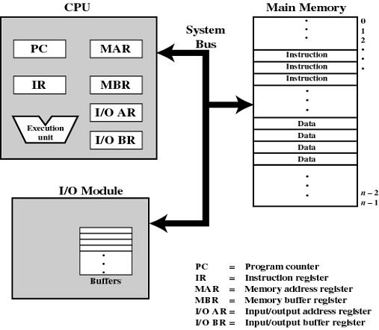
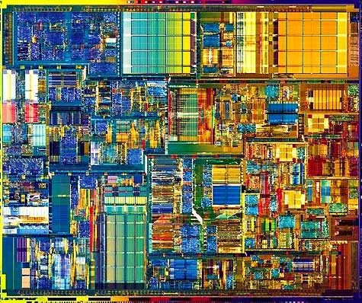
1.1 Basic Elements

Slide 12
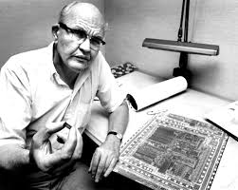
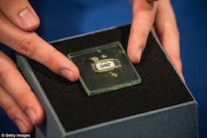
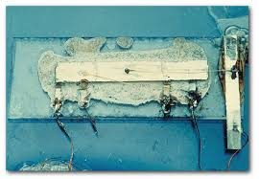
1.2 Microprocessor Evolution
Jack St. Clair Kilby (November 8, 1923 – June 20, 2005) was an American electrical engineer who took part (along with Robert Noyce) in the realization of the first integrated circuit while working at Texas Instruments (TI) in 1958.
Kilby was awarded the Nobel Prize in physics on December 10, 2000. He is also the inventor of the handheld calculator and the thermal printer (and seven others), for which he has patents.
https://www.youtube.com/watch?v=vXDRF5wvp-o

Slide 13
1.3 Instruction Execution

Slide 14
1.3 Instruction Execution

Slide 15






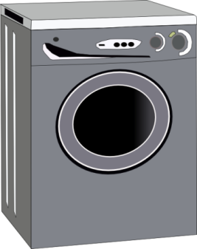
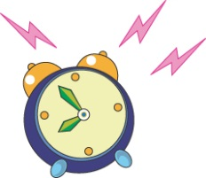
1.4 Interrupts
Interrupt
Main Routine
(synchronous)
Main Routine
(synchronous)
Main Routine
(synchronous)
Main Routine
(synchronous)
Interrupt Service Routine
(asynchronous)
Interrupt Service Routine
(asynchronous)
Interrupt Service Routine
(asynchronous)

Slide 16
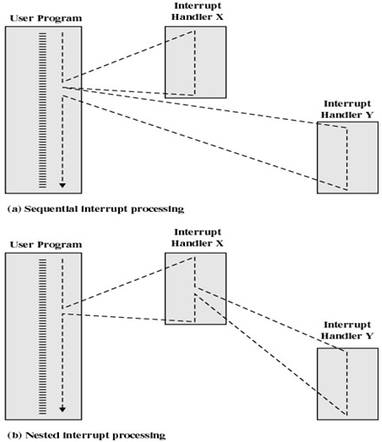
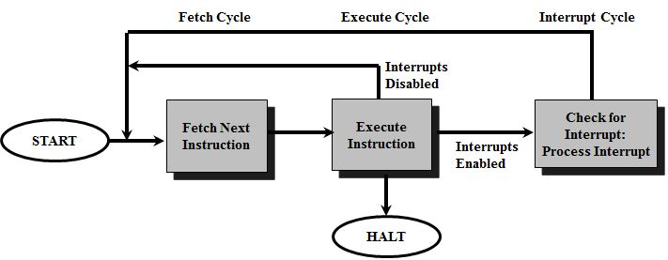
Interrupts
The interrupt was the principle tool available to system programmers in developing multi-tasking systems!
Classes of Interrupts
Program: arithmetic overflow, division by zero
Execute illegal instruction
Reference outside user’s memory space
I/O: Timer, DMA
Hardware failure
Interrupt control
Disable during ISR
Allow Interrupts?
Allow higher priorities?

Slide 17
1.5 Memory Hierarchy
More Expensive
Faster & Smaller
Registers
Cache
Main Memory
Disk Cache
Bigger
Slower
Magnetic Disk
Magnetic Tape
Optical Disk

Slide 18
1.6 Cache Memory
Memory Cache
Small caches have a significant impact on performance.
Increase block size until probability of using newly fetched data < reusing data that has been moved out of cache
main memory must be current for direct memory access by I/O modules and multiple processors
Disk Cache
Disk writes are clustered – use a portion of main memory as a buffer to temporarily to hold data for the disk.
Some data written out may be referenced again. The data are retrieved rapidly from the software cache instead of slowly from disk
I/O Cache
Circular buffers
Lists / Streams

Slide 19
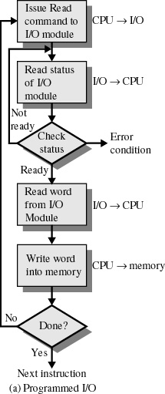
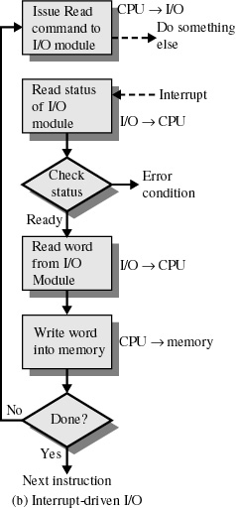
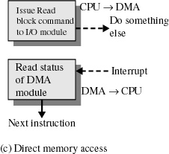
1.7 Direct Memory Access

Slide 20
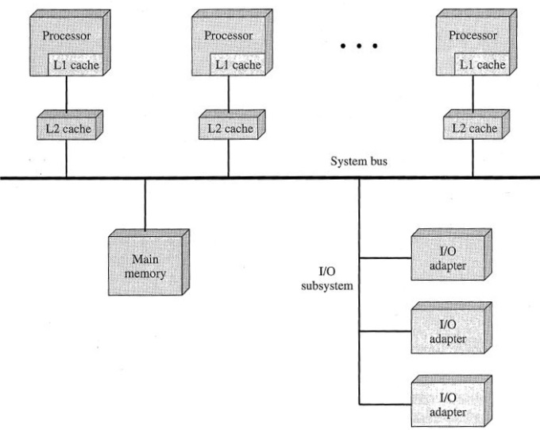
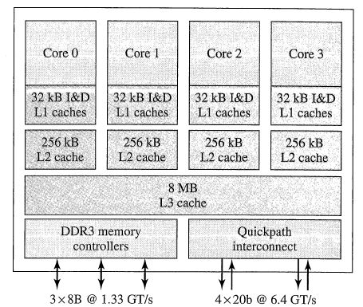
1.8 Multi Processor/Core
Traditionally, the computer has been viewed as a sequential machine.
Multiple control signals
Pipelining
Parallelism
Multiprocessors (SMP)
2 or more identical processors that share resources
Integrated OS to control jobs, tasks, files, data elements…
High degree of interaction/cooperation between processes
Multicore Computers
Single piece of silicon (die)
Independent processors + levels of cache
Intel Core i7
Prefetching
Cluster computing
Loosely coupled - network
Client / server environment
Middleware
DME, RPC

Slide 21
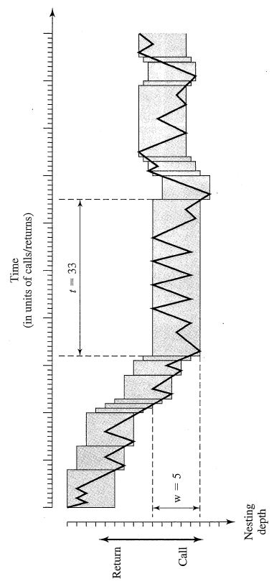
Locality
Locality
Spatial locality – clustered access
Large cache
Pre-fetch
Temporal locality – recent/repeated access
Cache Least Recently Used (LRU)
Cache hierarchy

Slide 22
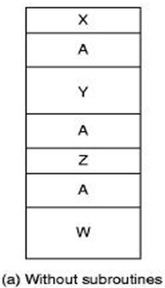
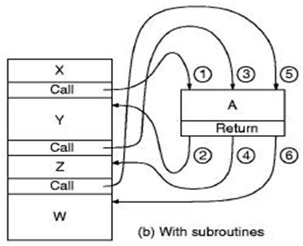
The Call / Return Mechanism
Smaller programs.
Easier to maintain.
Reduces development costs.
Increased reliability.
Fewer bugs do to copying code.
More library friendly.
Faster programs.
Less overhead.

Slide 23
Finally…
Operating System Tradeoffs
Convenience vs efficiency
Ease of use vs maximum resource utilization
Interactive user interface vs no user view
Asymmetric vs symmetric processing
Single-processor vs multiprocessor systems
Unicore vs multicore systems
UMA vs NUMA
Batch vs time sharing
Logical vs physical memory
Dual mode vs multimode
Notes:
UMA = uniform memory access
Non-uniform memory access (NUMA) is a computer memory design used in multiprocessing, where the memory access time depends on the memory location relative to the processor. Under NUMA, a processor can access its own local memory faster than non-local memory (memory local to another processor or memory shared between processors). The benefits of NUMA are limited to particular workloads, notably on servers where the data are often associated strongly with certain tasks or users.[

Slide 24
